Slide 1
RUNGTA COLLEGE OF DENTAL SCIENCES & RESEARCH
TITLE OF THE TOPIC: COMPLEXAMALGAM RESTORATION
DEPARTMENT OF CONSERVATIVE DENTISTRY AND ENDODONTICS

Slide 2
Specific learning Objectives
At the end of this presentation the learner is expected to know ;
Core areas* | Domain ** | Category #
ANATOMICAL ASPECTS OF PIN RETAINED RESTORATION | COGNITIVE | MUST NOW
MECHANO ANATOMICAL ASPECTS OF PIN RETAINED RESTORATION | PSYCHOMOTOR | NICE TO KNOW
PIN ALIGNMENT | AFFECTIVE | DESIRE TO KNOW

Slide 3
Table of Content
Mechano anatomical principles for pin placement
Principles for pin placement.
Complication during pin placement
Failure of pin retained restorations
Slot retained amalgam restorations
Amalgam foundations
Chamber retention
Restorative technique
Bonded amalgam
Conclusion
References

Slide 4
D.Cavity end of pin is chisel or wedge shaped or irregular →creation of shear line→ fatigue of restoration
E.Non adaptability of the restorative material to the pin will induce stresses. Amalgam offers less voids and more adaptability around pins than composite resins do.

Slide 5
PINS AND TENSILE STRENGTH
A. severe reduction (30-40%) in tensile strength➔ if the pins are placed at right angles to the direction of the tensile stresses in the restoration.
B. moderate reduction in tensile strength ➔ if the pins are placed at 45⁰ to the direction of the induced stresses.
C. No reduction in tensile strength ➔ if the pins are placed parallel to the direction of tensile stresses in the restoration.

Slide 6
ANATOMICAL ASPECTS OF PIN RETAINED RESTORATIONS

Slide 7
ANATOMICAL ASPECTS OF PIN-RETAINED RESTORATIONS
KNOWLEDGE OF ANATOMY
full comprehension of the tooth anatomy, its invested and investing tissues, particularly in a spatial three-dimensional pattern is basic to the drilling of pin channels without perforation or encroaching on that essential anatomy.
B) RADIOGRAPHS
Although x-rays only illustrate the tooth in one plane, they are helpful in getting a basic idea about the dimensions of the dentin in this plane.

Slide 8
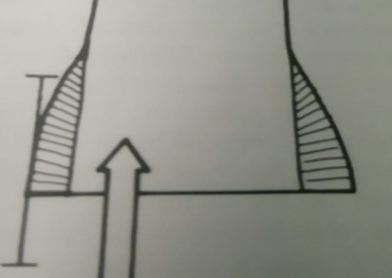
C) OUTER SURFACE OF THE TOOTH
The outer surface of the tooth next to the contemplated location of the pin in the dentin is the ideal guiding landmark for drilling location and angulation
D)AMOUNT OF DENTIN
Factors which lead to the obliteration of pulp chamber or root canal space will increase the dimension of dentin
Previous pathology or instrumentation – may enlarge the space – decreasing the dimension of dentin
E)ANATOMICAL FEATURES
Abnormal anatomy on tooth surfaces, in the form of grooves or concavities, approximating the planned pin location will increase the possibility of surface perforation

Slide 9
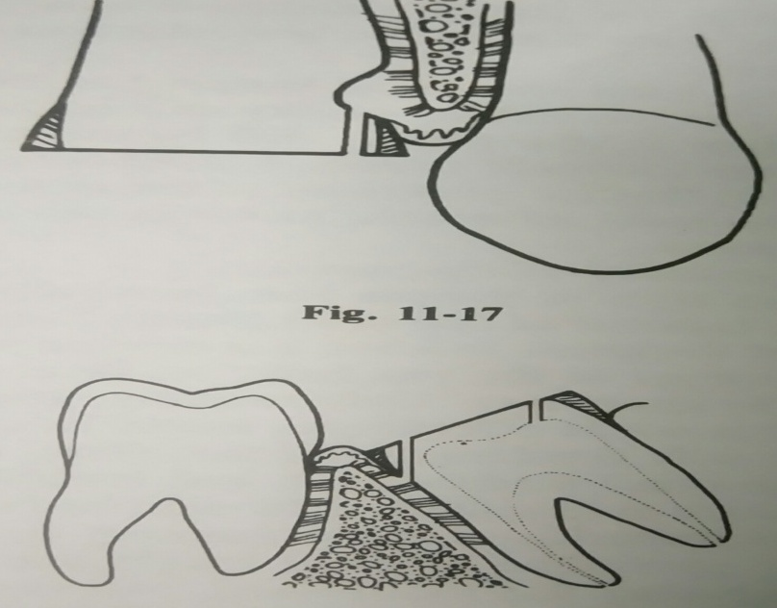
F. TOOTH ALIGNMENT
Mal alignment of teeth in the form of rotation or inclination , necessitates individual evaluation of the tooth involved to determine the best access, location, and angulation of pin channel.
One of the most difficult teeth in which to insert a pin is an inclined tooth which has completely lost its crown
Usually, a surface perforation occurs toward the inclination, or a pulp chamber (root canal system) perforation occurs away from the direction of the inclination.

Slide 10
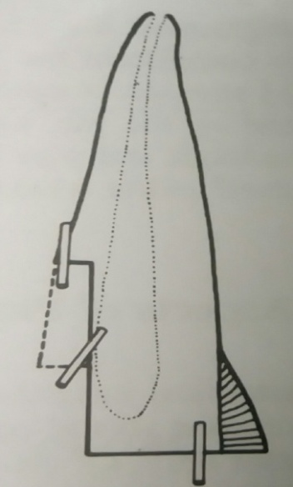
G. CAVITY EXTENT
The more apically located that a gingival floor is, the higher will be the possibility of surface and pulp-root canal perforation in trying to prepare a pin channel. This is due to:
decrease in dentin bulk
root surface concavities and grooves
and the taper of the tooth as one proceeds apically.
H. AGE OR RELATIVE AGE
Aging decreases the size of the pulp chamber and root canal system and increases the dentin dimension
e.g., first molars are always older and have bulkier dentin than third molars.

Slide 11
MECHANO-ANATOMICAL PRINCIPLES FOR PIN PLACEMENT
Maxillary Central Incisors
This tooth has four pulp horns—three in themesio-distal direction and one in thelabio-lingual direction (cingulum).
Thelateral hornsare close to theincisalangles and the whole pulp chamber is deviatedlingually.
Thecingulumpulp horn is the most pronounced
Ina cross-section at the cervical marginthere is an average of 1.5-1.8 mm of dentin circumferentiallygingivally, with more dentinlabiallythanlingually

Slide 12
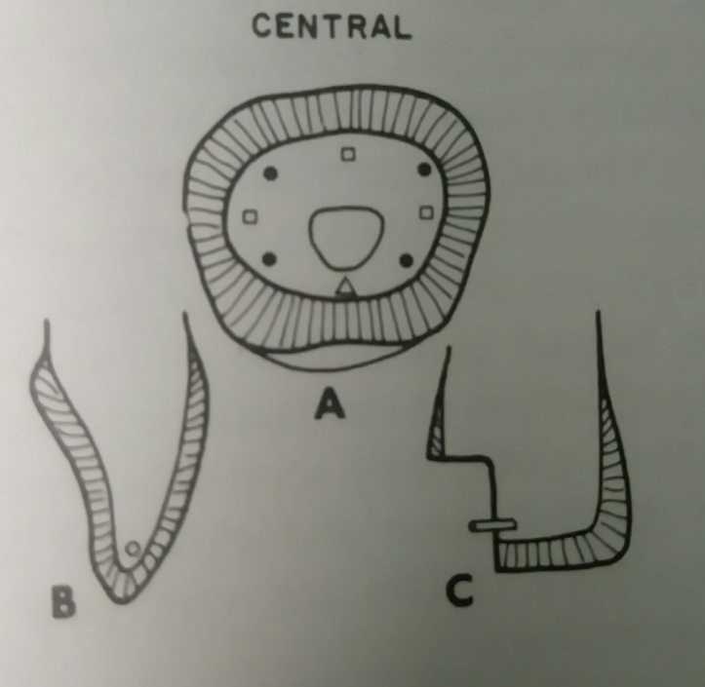
Maxillary Central incisors
PIN LOCATION | PIN ANGULATION
The ideal location is gingival, close to the proximo-labial and proximo-lingual corners. The second choice is the middle of a proximal gingival floor or the middle of a labial gingival floor The third choice is incisal, where there is at least 2 mm or more of dentin between the labial and lingual enamel plates Areas to be avoided include: the middle of a lingual gingival floor Incisal when the dentin between the labial and lingual enamel plates is not bulky enough to stand pin insertion without possible failure. Incisal near proximal pulp horn | Proximal and labial pins have slight labial angulation in labio-lingual direction Gingival pins have limited angulation( 10 – 20%) with the longitudnal axis of tooth in mesio distal direction. Incisal pins – parallel to incisal ridge

Slide 13
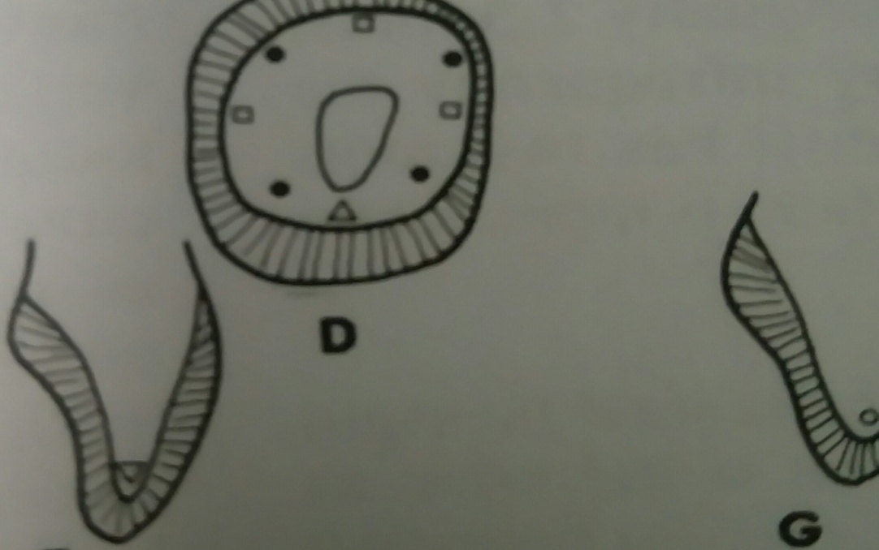
MAXILLARY LATERAL INCISORS
ANATOMY | PIN LOCATION | PIN ANGULATION
Similar to central incisors Circumfentially gingivally at the cervical line , there is an average of 1.2 – 1.5 mm dentin | Areas to be avoided : Middle of a lingual gingival floor and incisally | Gingival pins – more angulation ( 15 -20%) with the longitudnal axis of the tooth in mesio distal direction

Slide 14
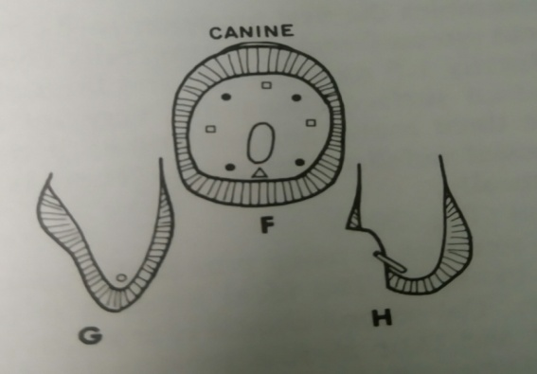
Maxillary cuspid
ANATOMY | PIN LOCATION | PIN ANGULATION
In this tooth, the pulp chamber has only two pronounced surface wise projections, incisally in the middle of the tooth and lingually (cingulum). The pulp chamber is lingually deviated. At a cervical line cross-section, on the average there is from 2.5-3.5 mm of dentin circumferentially gingivally | The ideal location is at or close to the facio- and linguo-proximal corners of the tooth. The second choice is the middle of a proximal gingival floor and middle labial gingival floor. The third choice is incisal, close to incisal angle. Areas to be avoided include: middle of lingual gingival floor, gingival pins close to surface Concavities or grooves, which can occur proximally. | Gingival pins proximally and gingivally should have a slight labial angulation in the labio-lingual direction. All gingival pins should form an angle with the long axis of the tooth in mesio- distal direction, coinciding with the taper of the root ( 20 – 35º) Incisal pins – parallel to the adjacent proximal slope of the tooth

Slide 15
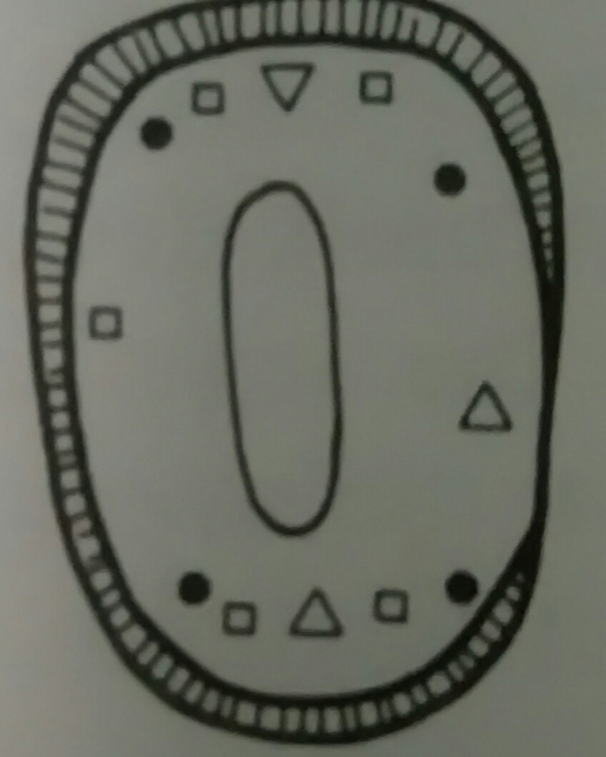
MAXILLARY FIRST BICUSPID
ANATOMY | PIN LOCATION | PIN ANGULATION
The pulp chamber in this tooth is narrower mesio-distally than bucco-lingually. . There are two pulp horns, of which the buccal is the most pronounced. The tooth may be birooted, having a mesial and a distal furcation. It may also be trirooted in which case there is an additional facial or lingual furcation. Circumferentially gingivally at the cervical line, there is an average of 2 mm of dentin bucally and lingually, 1 mm mesially and 1.5 mm distally. There is more dentin lingually than bucally. | The ideal location is at or close to the proximo-facial and lingual corners of the tooth gingivally. The second choice is gingival between the corners of the tooth and the middle of axial surfaces with the exception of the mesial surface. Areas to be avoided include 1.the mesial gingival floor (canine fossa) 2.the middle of the gingival floors bucally and lingually 3.Gingival floors Occlusal to furcation | All gingival pins should be parallel to the longitudinal axis of the tooth.

Slide 16
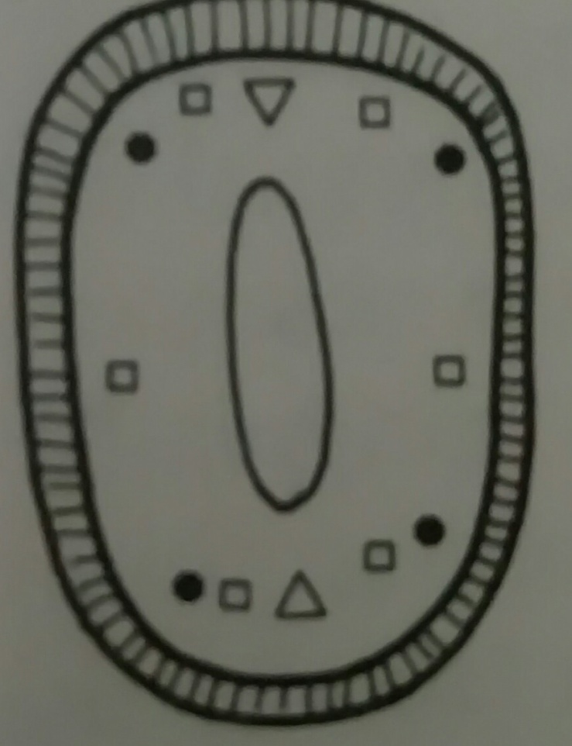
Maxillary second premolar
ANATOMY | PIN LOCATION | PIN ANGULATION
This tooth resembles the first premolar in its pulp anatomy circumferentially gingivally (on the average mesially and distally 1.5 mm, bucally and lingually 2.5 mm) it has two roots with possible mesial and distal furcations. There is more dentin Iingually than buccally. | The ideal location is the same as for first premolars. The second choice is at gingival floors between the corner and their middle proximally, facially, and lingually. Areas to be avoided include : the middle of the gingival floor facially and lingually (concavity of the pulp chamber), areas of the gingival floor occlusal to furcation, if present. | All gingival pins should be parallel to the longitudinal axis of the tooth

Slide 17
MAXILLARY FIRST MOLAR
There are four pulp horns, themesio-buccalone is the most pronounced.
There are threefurcations; one is locatedbuccally, and each of the other two are located proximally.
The proximalfurcationsare deviatedlinguallyand inwards.
The walls of the pulp chamber are almost convex inwardly
Circumferentiallygingivallyat the cervical line, the dentin measures an average of 2-2.5 mmmesiallyand distally and 2.5-3.5 mmbucallyandlingually
The closestfurcationto the surface is thebuccal, followed by the distal and the deepestfurcationapically and inwardly is themesialfurcation.

Slide 18
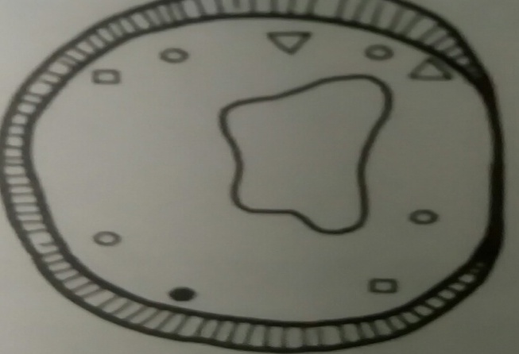
PIN LOCATION The ideal location is the gingival floor at or close disto-lingual corner. The second choice is the disto-buccal and mesio-lingual corner of the tooth. The third choice is the gingival floor Iingually, mesially and distally. avoid the furcation and the isthmus portion of the future restoration. | PIN ANGULATION
 | Gingival pins facially and lingually should be approximately parallel to the occlusal two-thirds of the lingual surface . Gingival pins mesially and distally should be parallel to the longitudinal axis of the tooth Areas to be avoided include the gingival floor or tables at the mesio-buccal corner of the tooth, any part of the gingival floor occlusal to a furcation (facially and proximally) its flutes, or a root concavity areas mesio-buccal to the cusp tips (pulp horns).

Slide 19
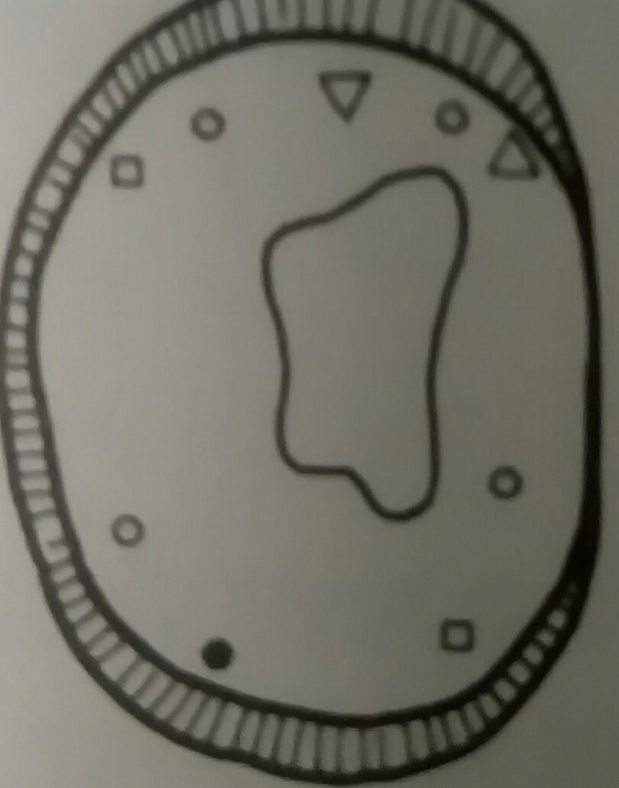
Maxillary second molar
This tooth is very similar to the first molar in all aspects, except there may be less dentin circumferentially gingivally and the pulp horns are less pronounced
.

Slide 20
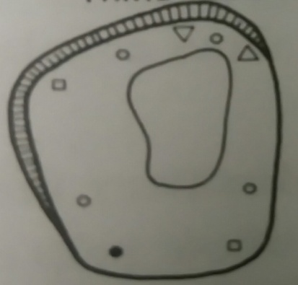
MAXILLARY THIRD MOLAR
This is youngest upper tooth and Unfortunately, there are numerous variations in its morphology & pulp anatomy if quadri tubular, it can be similar to first molar.
Generally speaking, the pulp chamber can be more occlusally located, and its walls can be expected to converge more toward the cervical line following the slope of tooth crown.
There is always a disto-buccal inclination of crown, which can invite distal and buccal surface perforation as well as mesial and lingual pulpal perforation
To avoid unwanted perforation or encroachment during pin channel preparation in these teeth, they should be studied carefully and the placement decided upon and executed carefully

Slide 21
MANDIBULAR CENTRAL INCISORS
This tooth has a very peculiar pulp chamber, which is widermesio-distally at itsincisalhalf thanlabio-lingually.
The pulp chamber is generallylinguallydeviated circumferentiallygingivallythe tooth has the least amount dentin in a cross section, 0.8-1.7 mm on the average
There are three pulp horns: two in themesio-distal direction and one in the lingual direction (the most pronounced of three)
There is more dentinlabiallythan proximally orlingually

Slide 22
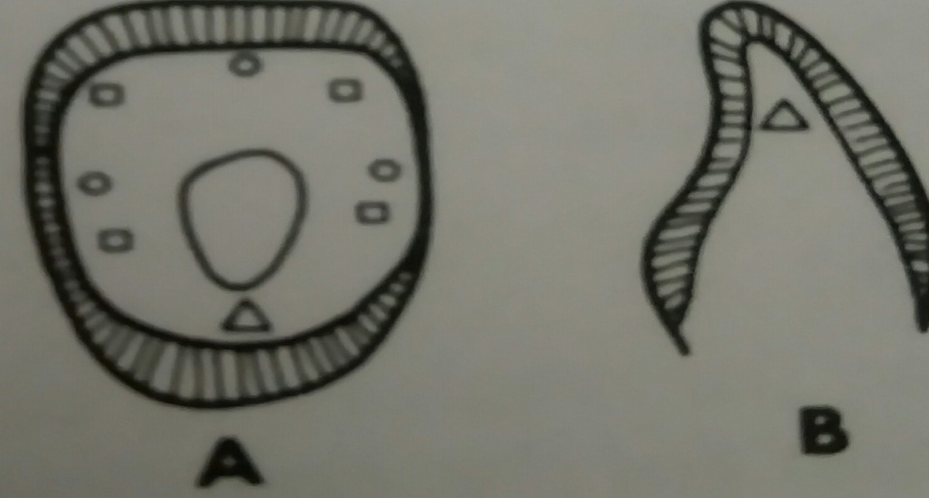
PIN LOCATION There is no ideal place for pin location in this tooth. In fact , pins are to be avoided as retention means for restoration in this tooth. Pins may be used at the gingival floor proximally in an aged tooth where the pulp has receded appreciably | PIN ANGULATION
 | Gingival pins- should be angulated slightly labially in the linguo-labial direction. Mesio- distally, to prevent perforation to the root surface or involving the mesio-distal widening of the pulp chamber in its incisal half, pins could have an angulation of 30-40° to the longitudinal axis of the tooth. Incisal pins- no place for in this tooth.

Slide 23
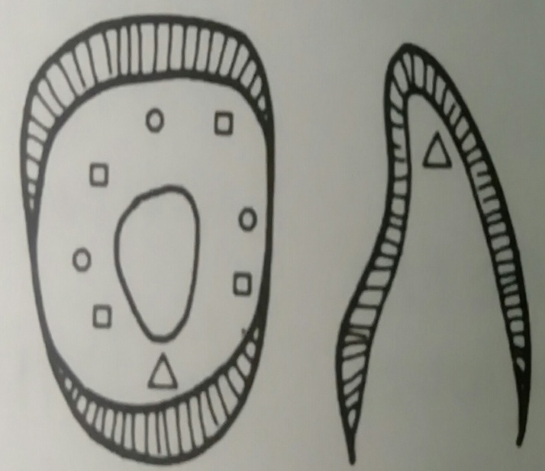
MANDIBULAR LATERAL INCISORS
ANATOMY | PIN LOCATION | PIN ANGULATION
The tooth and pulp chamber are more fan-shaped inciso-apically. Circumferentially gingivally in cross-section, the tooth has an average 1-2 mm dentin. | Pins should be located exactly as in the central incisor similar advice not to use pins except in aged teeth | This tooth is similar to the central incisors, except in mesio-distal direction, the angulation relative to the long axis of the tooth could be up to 50° to avoid perforation and encroachment

Slide 24
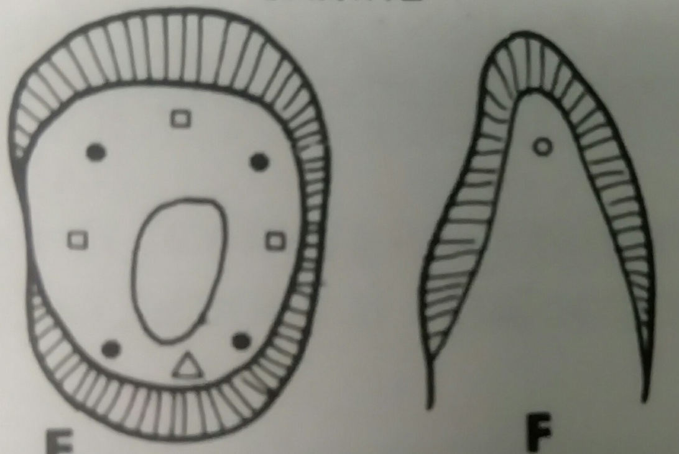
MANDIBULAR CUSPID
ANATOMY | PIN LOCATION | PIN ANGULATION
the pulp chamber is slightly compressed mesio distallv the pulp horns are a little bit blunt in this tooth and there is a distant possibility of two root canals. Circumferentially gingivally, the average amount of dentin in a cross-section 2.2-3 mm, with more dentin labially than mesially, distally and lingually. | Very similar to those of the upper cuspid

Slide 25
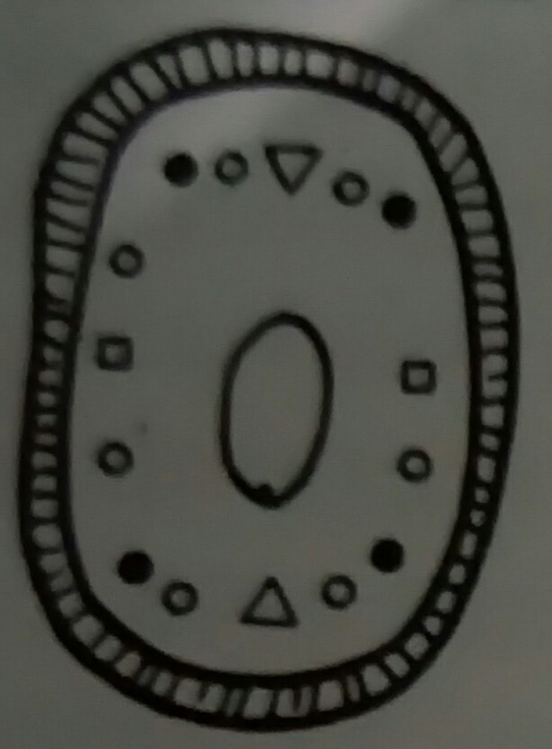
MANDIBULAR FIRST BICUSPID
ANATOMY | PIN LOCATION | PIN ANGULATION
It has a very pronounced buccal pulp horn and, infrequently, a blunt lingual pulp horn . The pulp chamber and most of the cervical half of the root canals is oval in shape. The pulp chamber is wider bucco-lingually than mesio-distally. The average thickness of dentin circumferentially gingivally at the CEJ is 2-2.5 mm. | Ideal location – proximo facial and proximo lingual corners of a gingival floor or table Second choice – gingival floor between mesial or distal corners Third choice – gingivally anywhere between the two distal or mesial corners , avoiding the isthmus part of the restoration Areas to be avoided: Middle of gingival floor , bucally and lingually | Parallel to the long axis of tooth

Slide 26
MANDIBULAR SECOND PREMOLAR
ANATOMY | PIN LOCATION | PIN ANGULATION
lingual pulp horn and the pulp chamber is more rounded. If it is a tricuspid premolar, its pulp anatomy will be different, in that the pulp chamber will be mesio-bucally deviated, with three pulp horns. Circumferentially gingivally, the average thickness of dentin at the CEJ is 2-3 mm bucally and lingually, 2.3-2.6 mm mesially and distally | In a tricuspid premolar, the ideal location is the distolingual corner on gingival floor Second choice – gingival floor other corners except mesio buccal one Third choice –mesiobuccal corner of gingival floor . Areas to be avoided include: Lingual groove Middle of buccal gingival floor | In bicuspid second premolars. angulation is- exactly like in first Premolars. In tricuspid premolars, it should be like first lower molars.

Slide 27
MANDIBULAR FIRST MOLARS
This tooth usually has five pulp horns, themesio-buccalbeing the most pronounced and closest to the surface
The whole pulp chamber ismesio-bucallydeviated with more dentin distally. especiallydisto-lingually, thanmesially, especially mesio-buccally
The floor of the pulp chamber is smaller than its roof.
The side walls of the pulp chambers are flat to concave inwardly.
Circumferentiallygingivally, the average thickness of dentin is 2-3 mm at the cervical line.
There are twofurcationsbetween themesialand distal roots: one in thebuccaland another in the lingual.

Slide 28
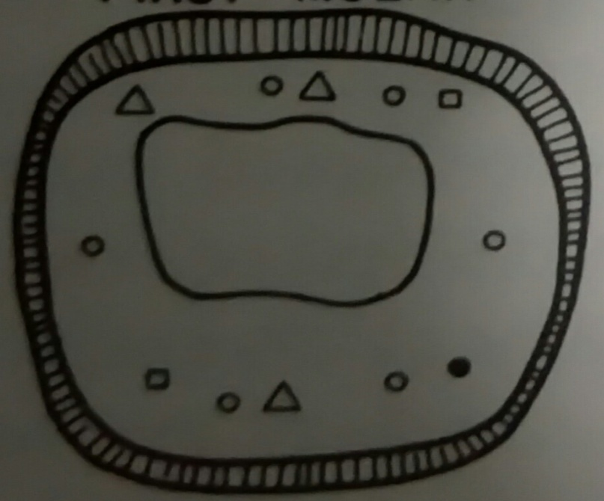
PIN LOCATION The ideal location is the disto-lingual corner gingival floor. The second choice is the disto-buccal and mesio-lingual corner gingival floor, The third choice is the gingival floor mesially or distally avoiding the isthmus portion of the future restoration. Areas to be avoided include mesio-buccal corner gingival floor the middle of the buccal and lingual gingival floors (furcation) mesio-buccal to any cusp tip (pulp horn). | PIN ANGULATION
 | Mesially and distally, gingival pins should be parallel to the long axis of the tooth. Bucally and lingually, gingival pins should be approximately parallel to the occlusal two-thirds of the buccal surface.

Slide 29
Mandibular second molar
This tooth is very similar to the first molar, except that the pulp chamber has four pulp horns only, and less surrounding dentin bulk.
Mandibular third molar
there are infinite anatomical variations in these teeth
They can have some similarities to first molars if they have five cusps, yet, they can be similar to the second molar if they have four cusps.
As in the upper third molars the pulp chamber in the lower is very much deviated occlusally, with severe flaring of the pulp chamber apically.
There is a great tendency for a mesio-lingual angulation of the tooth as a whole, which increases the probability of mesial and lingual surface perforation, together with distal and pulpal perforation in attempting to prepare pin channels there.

Slide 30
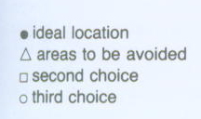

Slide 31
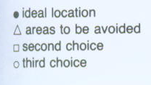

Slide 32
TAKE HOME MESSAGE
Because of its history, the complex amalgam restorations may be the most frequently placed complex restoration.
However due to the increasing benefits of composites, the many types of auxiliary retention forms available, and the variations of tooth preparations required for complex restorations, the operator should be familiar with all of these techniques, if he or she is to use these restorations on a regular basis.

Slide 33
QUESTIONS
HOW TO CHECK PIN ALIGNMENT
MECHANO-ANATOMICAL ASPECTS OF PIN RESTAINED RESTORATION

Slide 34
REFERENCES:
1. Sturdevant's Art and Science of Operative Dentistry - fourth Edition
2. Operative Dentistry - Modern theory and practice - First Edition- M.A. Marzouk
3. Text book of operative dentistry - Vimal K. Sikri
4.Fundamentals of Operative Dentistry- Summit JB- 2nd edition
5.Text book of operative dentistry → nisha carg,amit carg
6.Principles and Practice of Operative Dentistry-Gerald T. Charbeneau-Third edition.
7.Clinical operative dentistry-principles and practice→ramya Raghu,Raghu sreenivasan

Slide 35
THANK YOU

